Slide 1
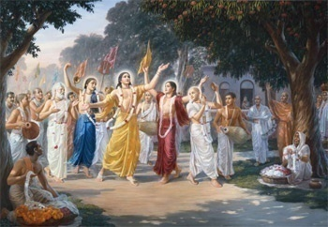
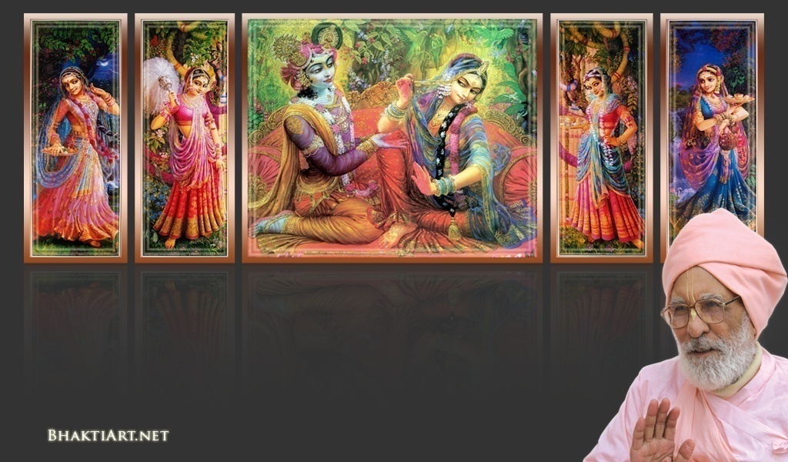
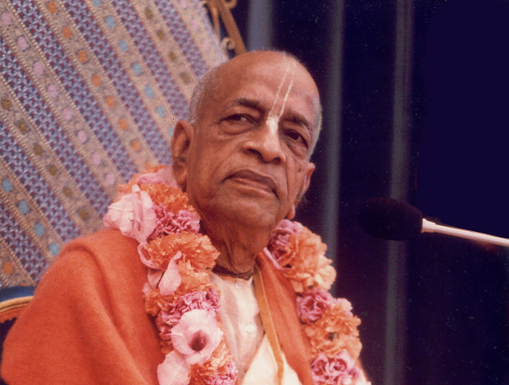
Sri Krsna Caitanya Prabhu Nityananda
Sri Advaita Gadadara Srivasadi
Gaura Bhakta Vrinda
Week 338
Apr 10 2015
Hare Krsna Hare Krsna
Krsna Krsna Hare Hare
Hare Rama Hare Rama
Rama Rama Hare Hare
Gokul Bhajan & Vedic Studies
North Carolina, USA
Notes:
Om Ajnana timirandhasya, jnananjana salakaya
Caksur unmimiltam yena, tasmai sri gurave namah
Namah om vishnu padaya, radhikayah priyatmane
Sri-srimad bhaktivedanta, narayana iti namine
Sri krishna lila kathane sudaksham
Audarya-madhurya gunais ca yuktam
Varam varenyam purusham mahantam
Narayanam tvam sirasa namami
He krishna karuna sindho, dina bandho jagat pate
Gopesha gopika kanta, radha kanta namo ‘stu te
tapta kancana gaurangi, radhe vrindavaneshvari
vrsabhanu sute devi, pranamami hari priye
bhajami radham aravinda netram
smarami radham madhurasmi-tasyam
vadami radham karuna bharardram
tato mam anyasti gatir na kapi
bhaktya vihina aparadha lakshai
ksiptas ca kamadi taranga madhye
krpamayi tvam saranam prapanna
vrinde numas te caranara vindam
--------------------------
First of all, I pay my koti dandavat pranams to my diksha guru Om vishnupada rupanuga acharya Sri Sri Bhakti Vedanta Narayana Goswami maharaja. My koti dandavat pranams to Sri Sri Bhakti Vedanta Swami Prabhupada, and guru varga.
My humble pranams at the lotus feet of all assembled devotees, vaishnavas and vaishnavis..

Slide 2
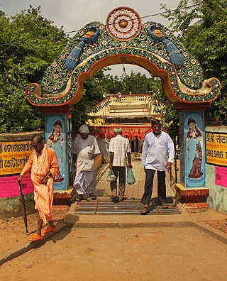
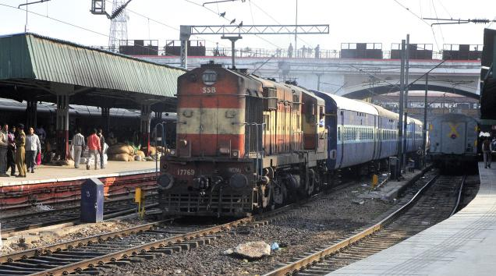
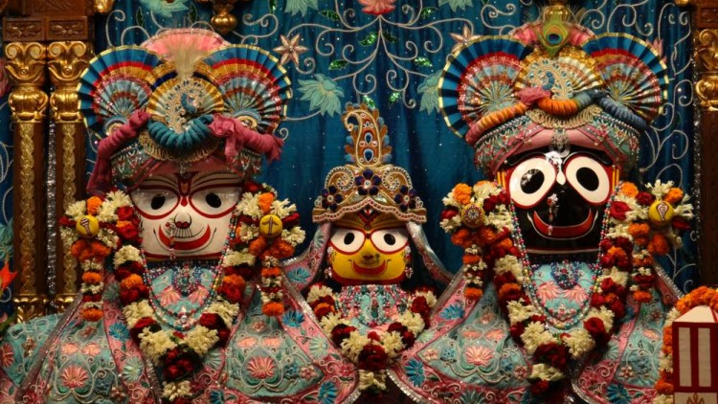
Sweet Memories from Pilgrimage – 2015 (Part-1)

Slide 3
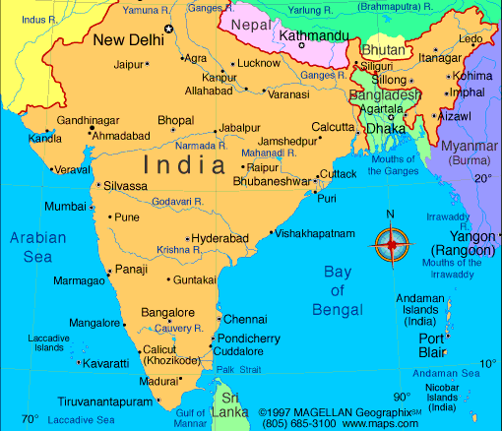
4 Weeks from Feb 23..
Chennai -> Kurdha Rd
Kurdha Rd to Puri
Puri to Calcutta
Calcutta to Nawadwip
Nawadwip to Calcutta
Calcutta to Delhi
Delhi > Aniruddh Prabhu
Aniruddh home to Jaipur
Jaipur to Mathura Vrindavan
Mathura to Pune, Kurdvadi
Kurdvadi to Pandarpur
Pandarpur to Kurdvadi
Kurdvadi to Manthralaya
Manthralaya to Sindhanur
Sindhanur to Kishkintha
Kishkintha to Sindhanur
Sindhanur to Bangalore
Bangalore to Chennai
Chennai to Kanyakumari
Notes:
....
Coromandal express.. Reservation was pending for months..
But on that day it got confirmed..
Muslims in the train at midnight..

Slide 4
Jagannath Puri Dham

Slide 5
Notes:
A dream many months before we even planned..

Slide 6
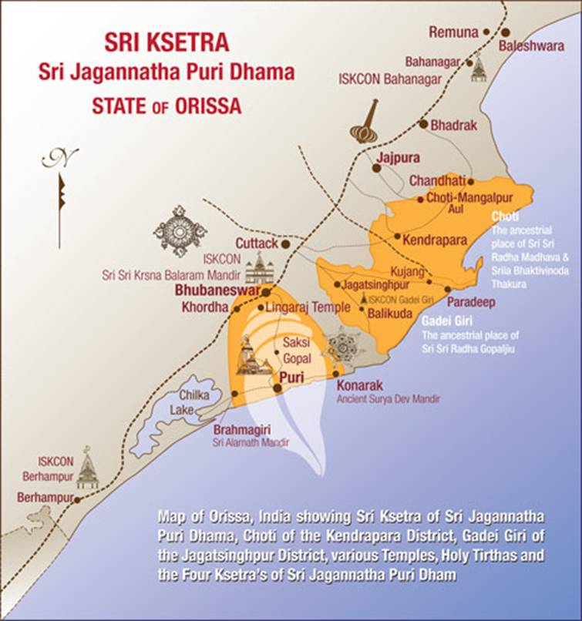
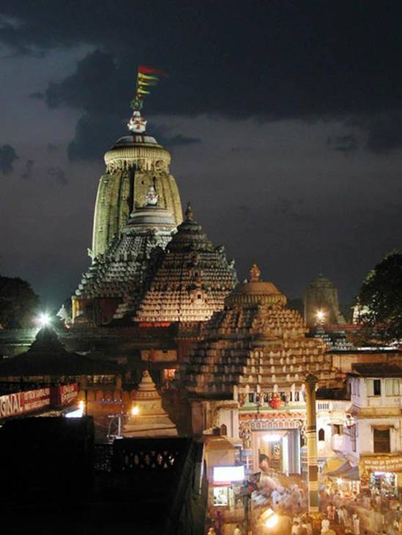
Notes:
Then we went to Jagannatha Puri..

Slide 7
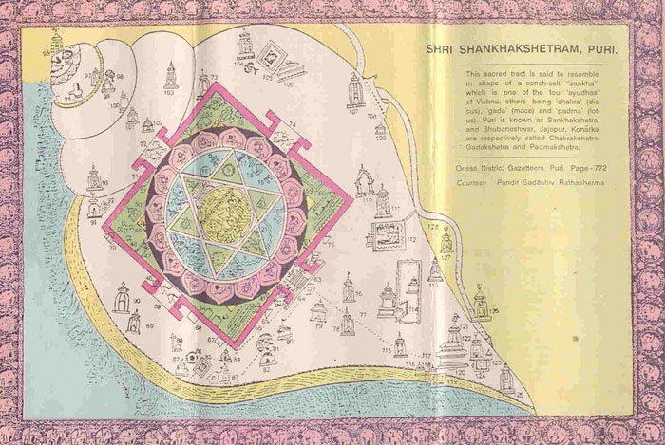
Notes:
Jagannath Puri is also called Shankha Ksetra
Never destroyed even at full annihilation of this Brahmanda.

Slide 8
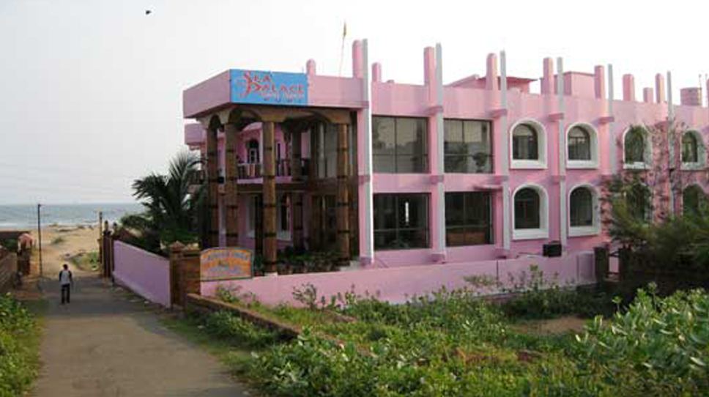
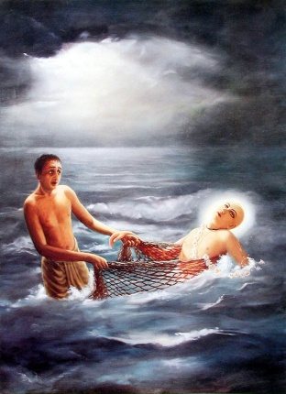
Near Chakra Tirtha
Notes:
Stayed in our Guru deva,'s Matt which is just near Charkra Tirtha where Lord Caitainya performed pastimes.

Slide 9
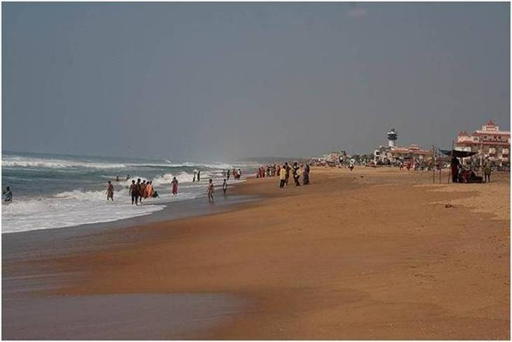
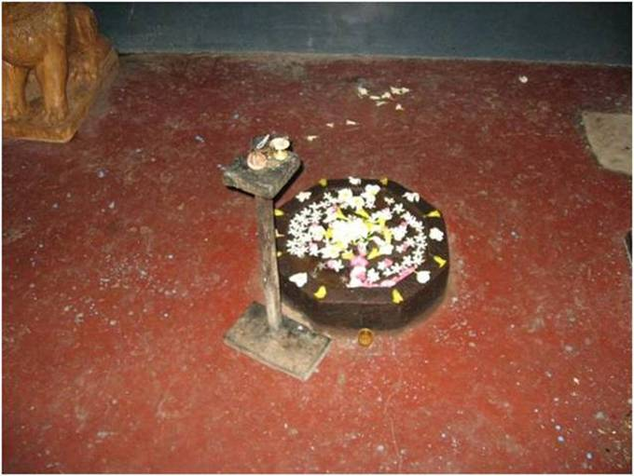
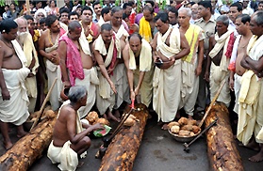
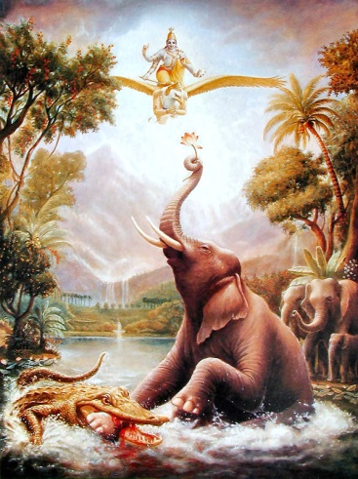
Notes:
This is also the very same place where the massive neem log to carve Lord Jagannatha appeared first in Satyuga yuga.
Also is the same place of Gajendra Moksha.
Abhaya Nrusingha, Chakra Nrusingha and Laxmi Nrusingha. These three different forms of Lord Nrusingha as worshipped at Chakratirtha have unique values in Hindu religion. The form of Abhaya Nrusingha represents Sri Balabhadra. The form of Chakra Nrusingha represents Goddess Subhadra and the form of Laxmi Nrusingha represents Lord Jagannath.
This is the abhode of Sri Lakshmi’s father Varuna..

Slide 10
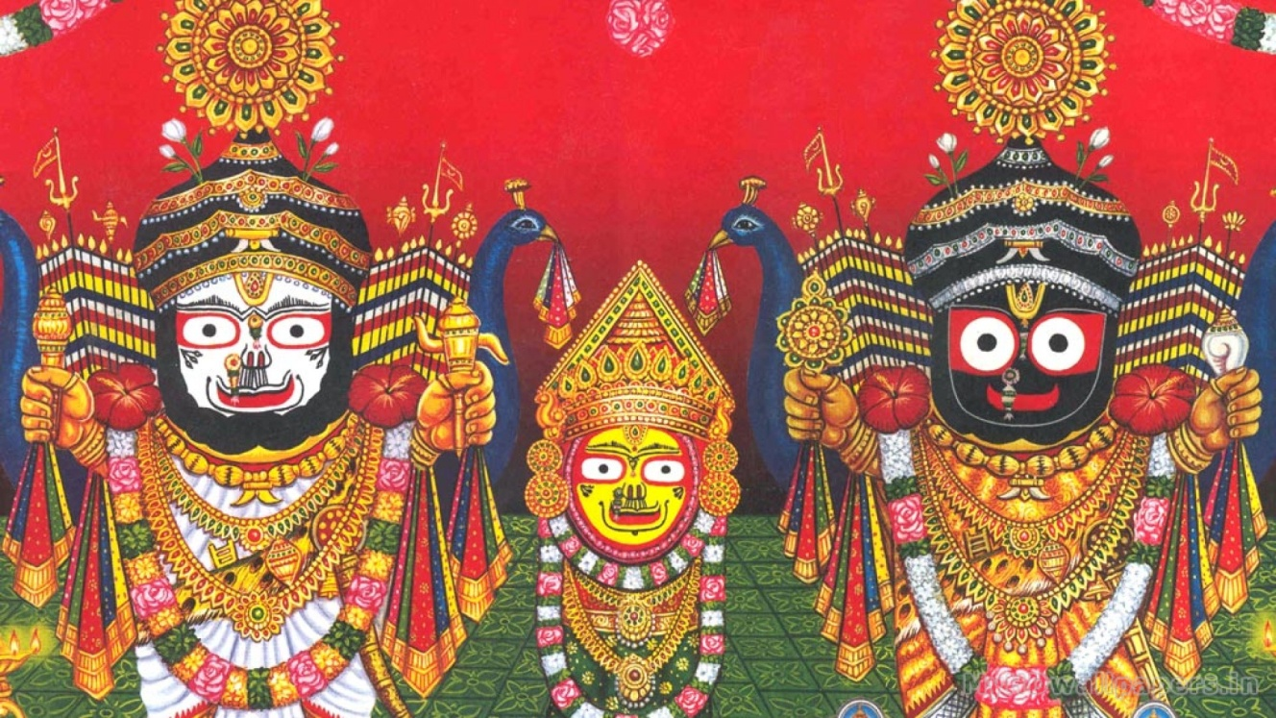
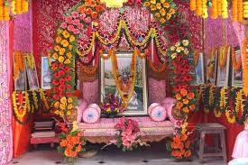
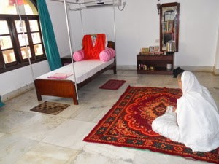
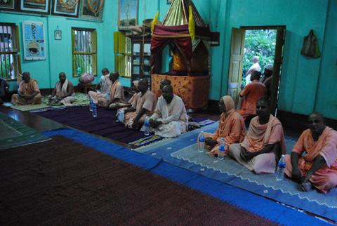
Notes:
Temple Room in the Matt of Srila Gurudeva.

Slide 11
Suddha Bakula – Bhajan Kutir of Srila Haridas Thakura

Slide 12
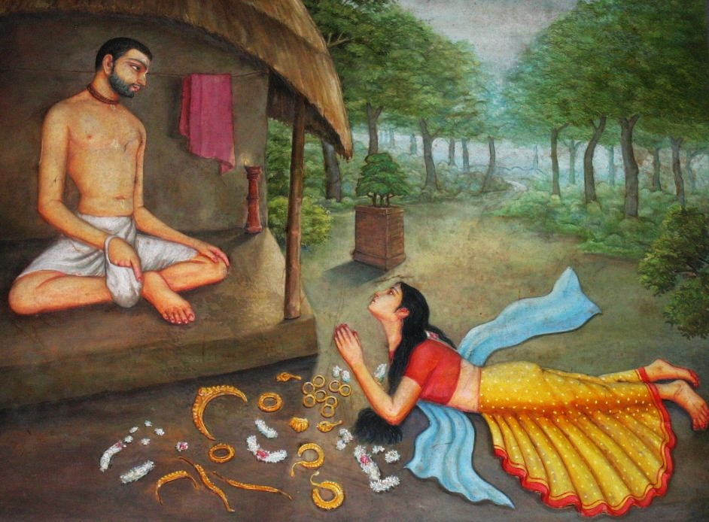
Notes:
Who is Srila Haridas thakura?
300,000 namas every day
Durga Devi took initiation from haridas Thakura..

Slide 13
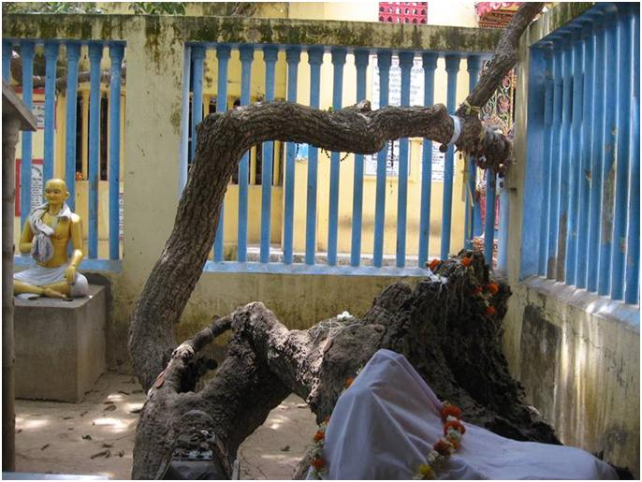
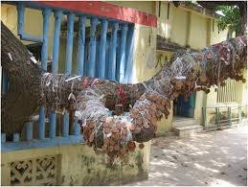
Notes:
Next day went to Srila Haridas Thakura's bhajn kutir and also saw the wonderful Suddha Bakula tree under which he used to chant.
Lord Caitanya personally used to bring prasadam to Haridas Thakur.
The wish tree!!!!

Slide 14
Samadhi Mandir of Srila Haridas Thakur

Slide 15
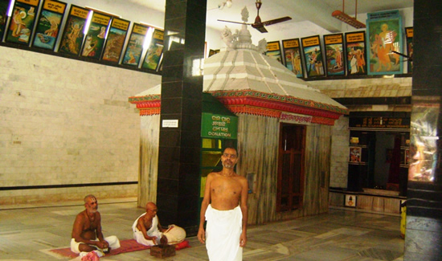
Notes:
This is the Samadhi mandir of Srila haridas thakura..

Slide 16
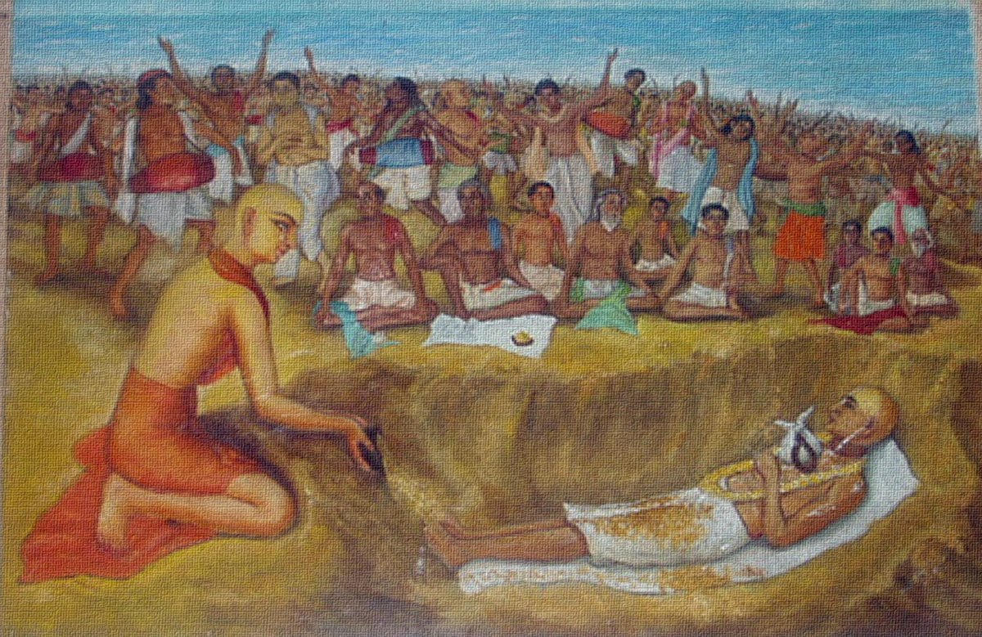
Notes:
Srila Haridas Thakura was older..
He left His body at the lap of Lord Caitanya looking at Lord’s face!
Lord Caitanya Himself gave samadhi to Srila Haridas Thakura..

Slide 17
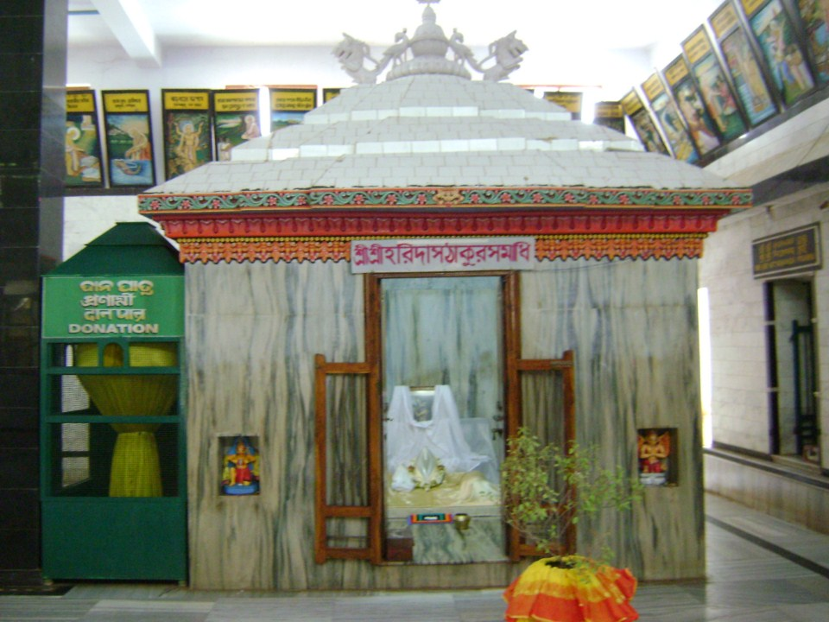
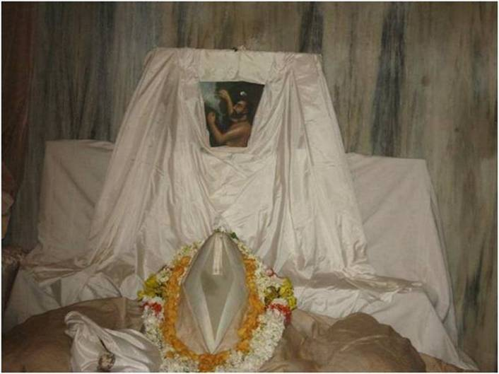
Notes:
Then we went to Srila Haridas Thakura's samadhi. Great vibration!
Lord Caitanya proclaimed that anyone dances at this place is sure to get Krishna Bhakti..

Slide 18
Tota Gopinath Temple

Slide 19
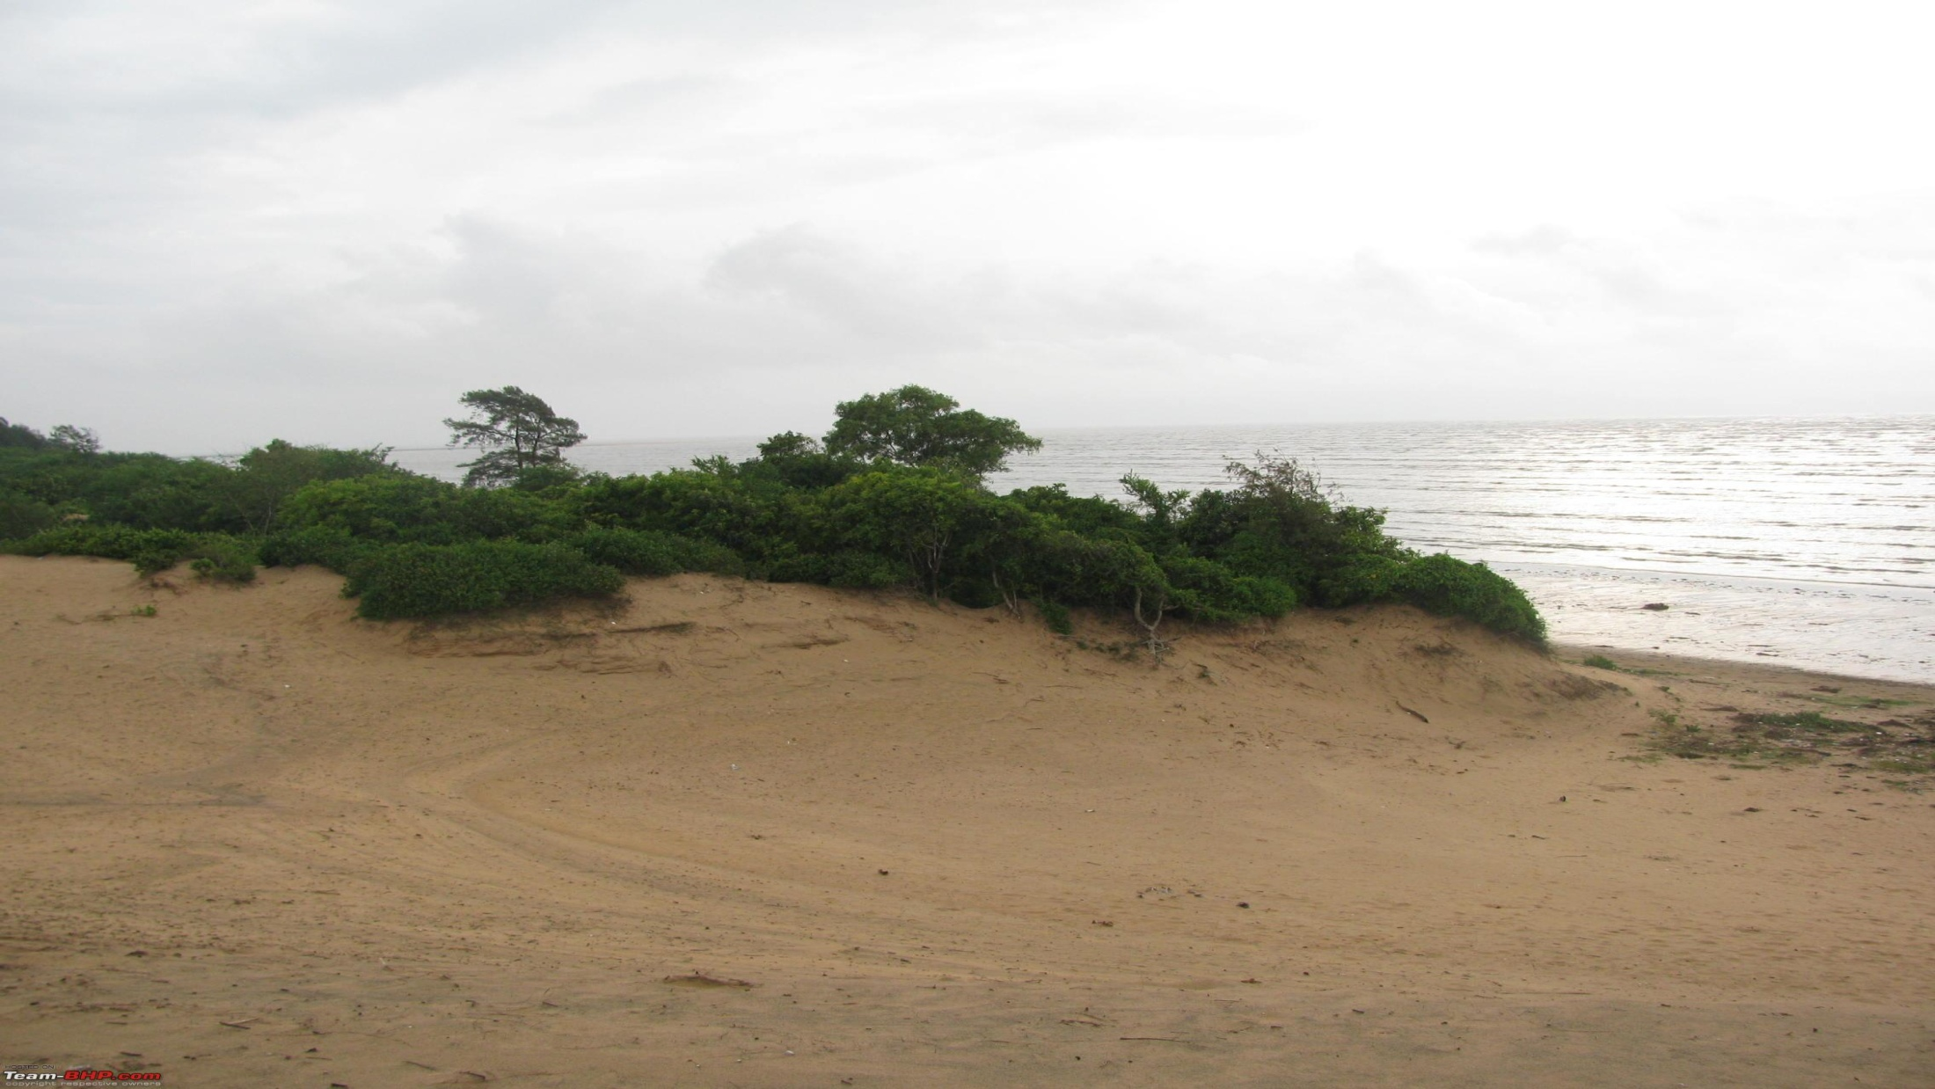
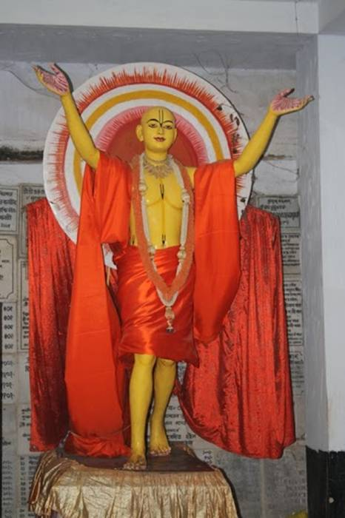
Notes:
Tota Gopinath was the deity brought out from the deep sand of Puri by Sri Caitanya Mahaprabhu..
This deity was also worshipped by Lord Brahma in some Yuga.
Mahaprabhu later merged into this same deity that we can see even today.

Slide 20
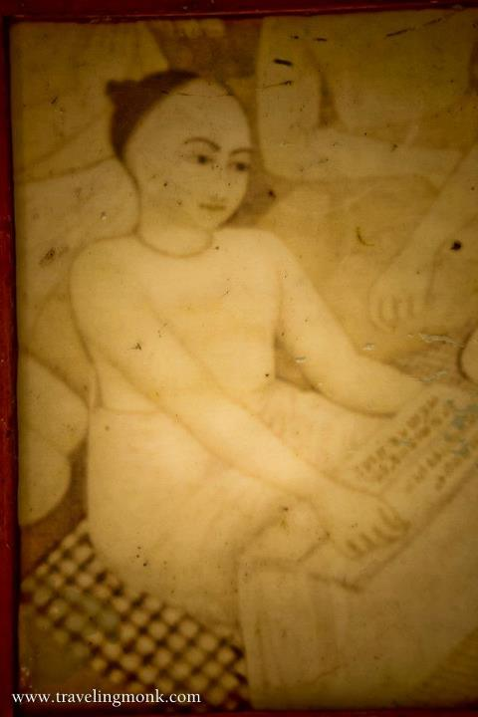
Notes:
Sri Tota Gopinatha graces the altar with Sri Radhika playing vina and Lalita sakhi playing flute on His left and right
Why are Radhika and Lalita both black?
Mahaprabhu merged into this deity
Gadadar pandit was given the duty of managing this deity by Lord Caitanya
When Gadadar pandit was old, he could not reach to put garland.
So the deity assumed a sitting position.
This is the only place Krishna is sitting.

Slide 21
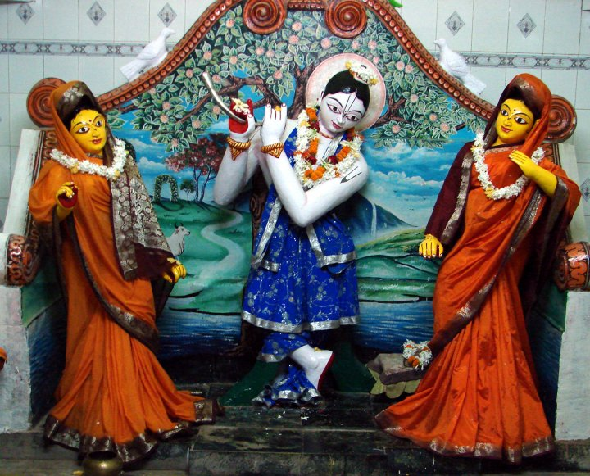
To the left altar at Sri Tota Gopinatha Temple features Lord Balarama with Revati and Varuni on His left and right.
Notes:
In Lord Caitanya’s pastimes, they came as:
Lord Nityananda
Janvavi
Vasudha

Slide 22
Chatak Parvat

Slide 23
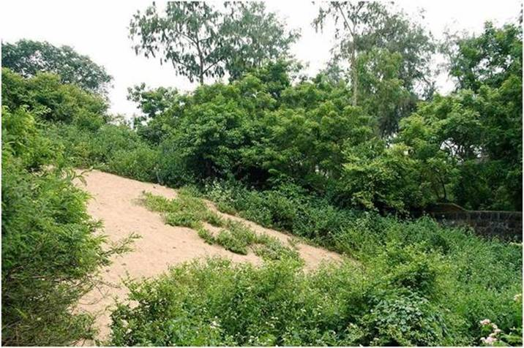
Notes:
Then we went to Chatak Parvat.
This is where Caitanya Mahaprabhu saw the Sand Dune as Govardan and ran to it..

Slide 24
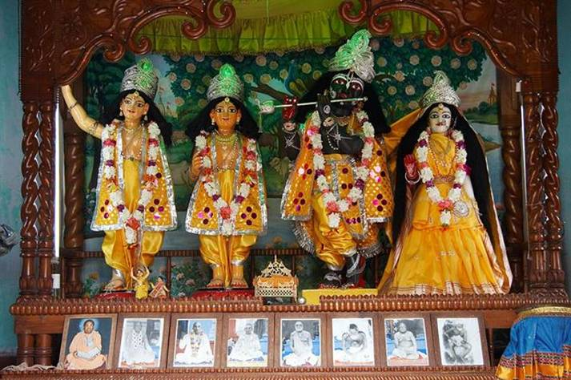
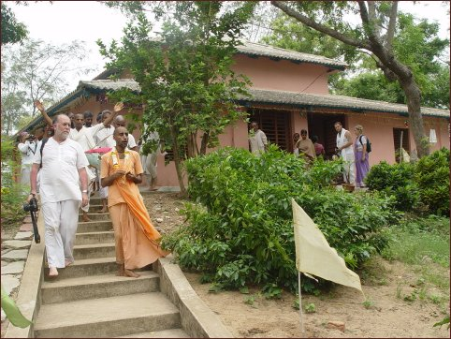
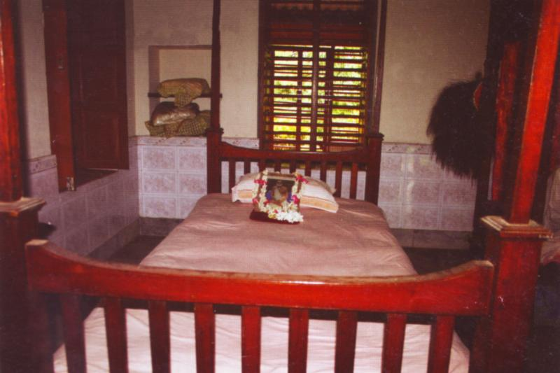
Notes:
Bhakti Siddhanta Saraswati Thakur established a nice temple here.
He also had his bhajan kutir here.

Slide 25
Temple of Lord Jagannath

Slide 26
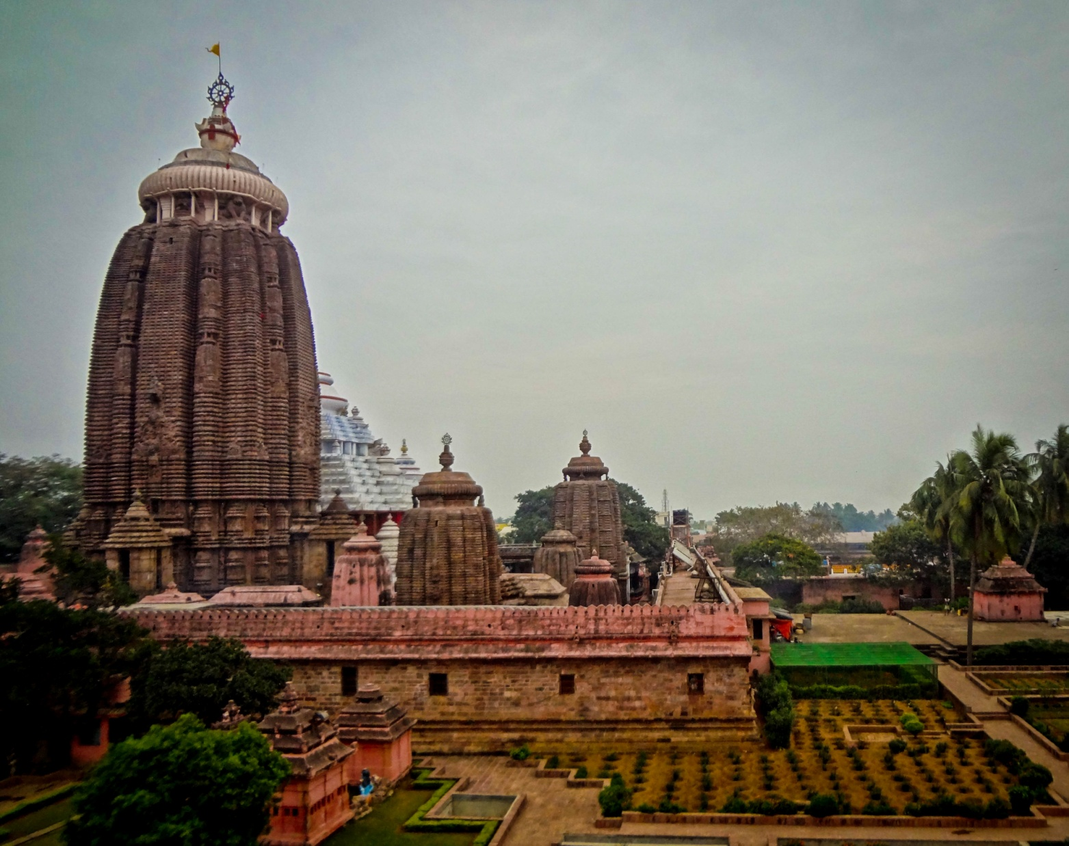
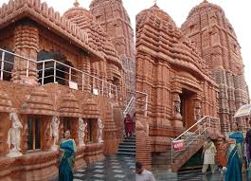
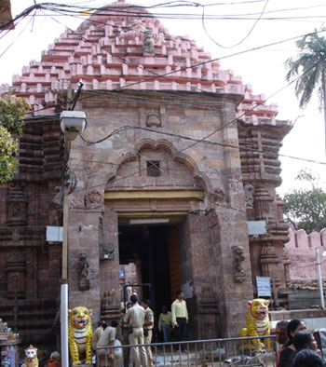
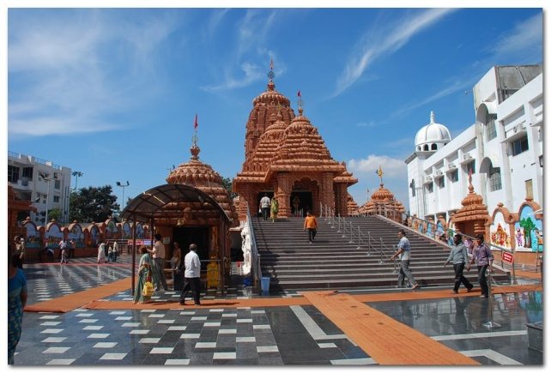
Notes:
Non-Hindus tread the Humble Path: Although many western born convert to Hindu thought and Gaudiya Vaishnavism in particular visit Puri, they cannot enter temple to see Lord Jagannatha because temple law forbids entrance of “non-Hindus”.
Such dogmatic prohibitions were not approved by Sri Caitanya Mahaprabhu.
Those who were thought unfit to enter Jagannatha temple,
Srila Rupa Goswami,
Sanatana Goswami,
Haridasa Thakura,
were daily visited by Caitanya Mahaprabhu, and this indicates that Mahaprabhu did not approve of the prohibitions. To avoid unnecessary turmoil, however, these great personalities did not enter the Jagannatha temple.

Slide 27
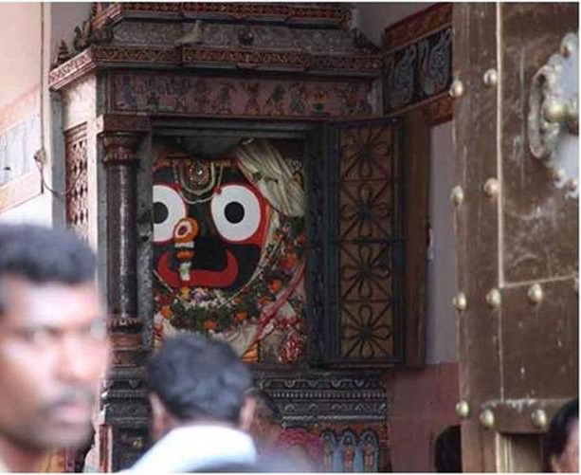
Notes:
In passage room of main gate is a Deity of Lord Jagannatha called Patita Pavana (saviour of the most fallen).
It is visible from the road. One can stand behind Aruna Stambha and respectively gaze at the Nila-Cakra, flags billowing atop Jagannatha’s temple and Patita Pavana Jagannatha in front, and then offer humble obeisances.
Seeing Nila-Cakra, flags and Patita Pavana Jagannatha is equal to direct darshana of Lord Jagannatha in the temple.
(Caitanya Caritamrta Madhya Lila 11.195 purport)
Why Only Hindus allowed?
--- Story of Muslim tried to kill the King f Puri and wonder happened at the entrance.
-- The law was passed by the King.

Slide 28
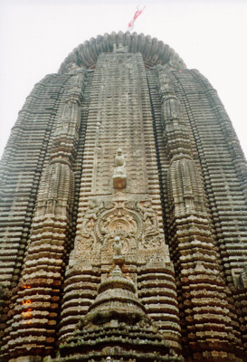
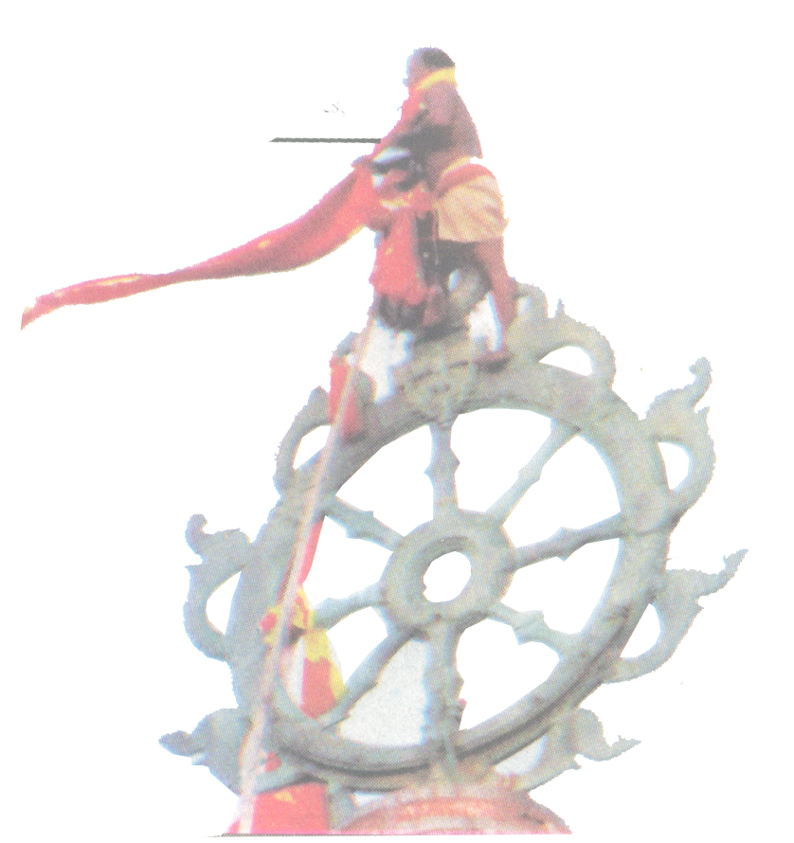
Notes:
We witnessed how a family serves by climbing to the top changing the flag several times a day..
A special family is serving for generations..
The male child born is trained to be out of fear of heights..
Trained by using climbing down and up in a deep well..
The flag is about 42 feet in width and flies only in one direction irrsepective of wind direction.

Slide 29
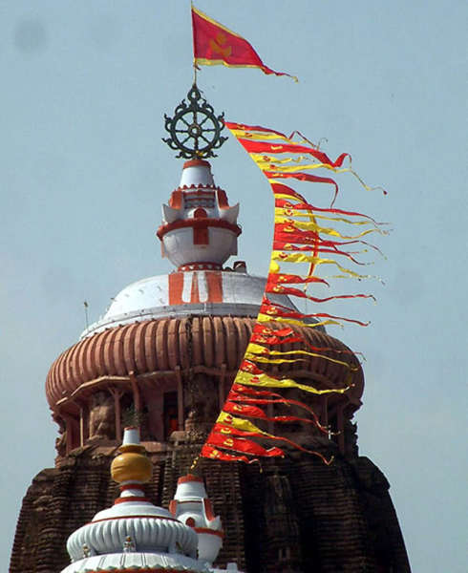
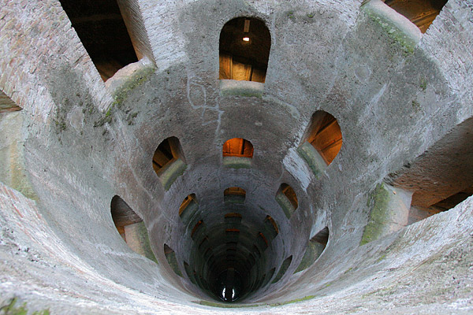
Notes:
A special family is serving for generations..
The male child born is trained to be out of fear of heights..
Trained by using climbing down and up in a deep well..
Flags are changed several times a day..

Slide 30
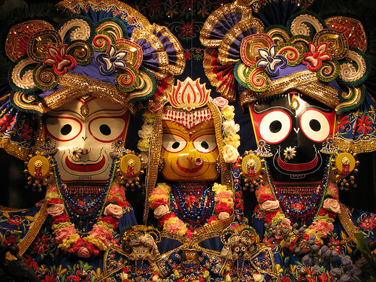
Notes:
When we enter the main temple, we see Lord Jagannath, Devi Subhadra and Lord Balaram majestically.
Crowd is too much!

Slide 31
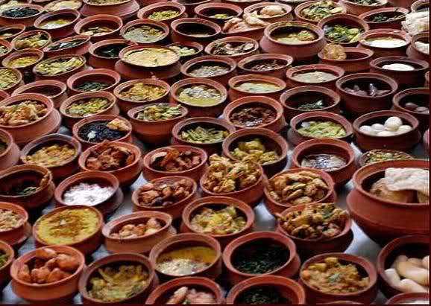
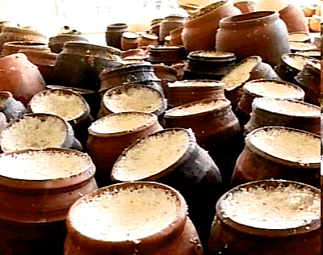
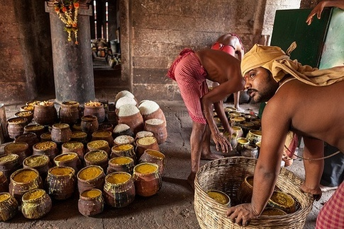
Notes:
Everyday Lord Jagannatha is offered 56 items (chappana bhoga) for His pleasure:
9 rice preparations, 14 subjis & curries, 9 milk preparations, 11 sweets, 13 cakes, pancakes and patties.

Slide 32
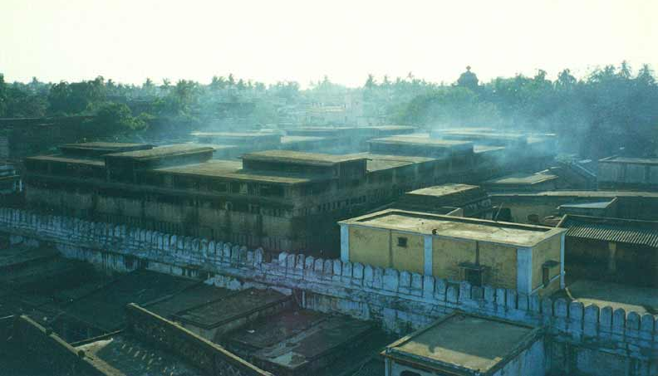
Notes:
100,000 people one day, and 250,000 is normal on a festival day.
Kitchen has 752 wood-burning stoves spread over 1 acre
600 cooks and 1,000 devotees work daily in the kitchen.
Chillies, onion, garlic, carrots, cabbage, potatoes, tomatoes, cauliflowers are not used in any preparation.
Without electricity or machines, skilled chefs work under oil lamps over open wood fires.
Every day, a fire sacrifice is performed in the temple kitchen. Afterwards, the cooks take embers from that sacrificial fire to ignite their individual stoves.
All bhoga is cooked in earthen pots.

Slide 33
Gambhira of Lord Caitanya

Slide 34
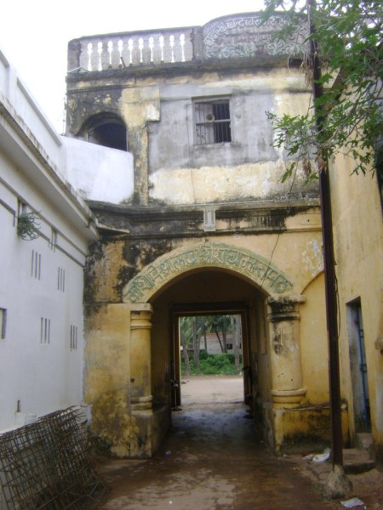
Notes:
Then went to Gambhira.
Left is the entrance to Gambhira which was actully the house of Kashi Mishra.
Right shown is the entrance to Gambhira itself..

Slide 35
Lord Caitanya’s room at Gambhira..
Notes:
Maha Prabhu stayed here for 12 years of His 18 years stay in Jagannath Puri.

Slide 36
OV-42
Svarņa koti darpaņābha deha varņa gauravam
Padma pārijāta gandha vanditānga saurabham
Koti kama mûrchitānghri rûpa rāsa rangaram
Prema dhāma devam eva naumi gaurasundaram
The luster of His fair body is brighter than a million brilliant mirrors of gold. Of such sweetness is the fragrance of His body that the aromatic lotus and parijata flowers humbly offer their prayers of worship. Millions of cupids, shocked out of their pride, swoon at His lotus feet, unable to bear the sight of His unparalleled beauty. His limbs are alive rasa moods of love that emerge and flow continuously from His beautiful form. I sing with joy the unending glories of my sweet Lord, my golden Gaurasundara, the one and only divine abode of pure love.

Slide 37
Notes:
Inside Gambhira.
The paduka, the kamandala and a quilt used by Lord Caitanya is kept inside the box.

Slide 38
Sri Radha Kanta (Kashi Mishra’s House)
Notes:
Sri Radha Kanta is worshipped in Kashi Mishra’s house. King Prataparudra’s father, Sri Purusottama Deva, conquered the king of kanchipura in battle and returned with three deities: Radha kanta, and Sakshi Gopala.
It is said Radha Kanta was also worshipped inside the Jagannatha Mandir for some time.
But in dream Lord Jagannatha informed the King Prataparudra to remove Radha Kanta deity because He was taking all nice items from his bhoga plate and so king requested to his Gurudev Kashi Mishra to take the Radha Kanta to his house.

Slide 39
Notes:
This is the part of the house of Sarvabhauma Bhattacharya where Lord Caitanya showed the Sadbhuja form.

Slide 40
Sweta Ganga

Slide 41
Notes:
This large sacred bathing tank is located just opposite Ganga Mata Math.
Puri residents say that Ganga-devi personally resides here in the form of Sweta Ganga so that she can regularly take darsana and serve Jagannatha Swami.
Being non-different from the Ganga, Sweta Ganga never becomes dry. Even if all the water is pumped out for some reason, it automatically refills. Remarkably, its water level rises or falls at the same rate as the Ganga river.
Sweta Ganga is one of the Panca Mukti Tirthas of Sri Ksetra Dhama.

Slide 42
Notes:
Sachi Devi was the daughter of a king in Bengal.
She did not want to marry a mortal prince.
After king and queen died, she had to take the kingdom and rule.
Her interest was to chant, renounced. Wished to ve in Vrindavan.
Srila Haridas Thakur helped as Guru.
First he refused as she was a queen and later asked her to go and live in Vrindavan live by begging.
She did so, and her body condition was deterirating. Haridas Thakura asked her to move to Radha Kunda.
Then he asked Sachi Devi to go to Jagannath Puri and preach.
She lived in the old home of Sarvabhauma and gave lectures on Srimad Bhagavatam.
Puri King Mukunda Deva got impressed and wanted to give her a place to stay. But she refused.
He made ‘White ganges’ a place representing ganges. This is the Sweta ganga we have now.
One day she wanted to take bath in Ganges and worship Lord Jagannath.
Lord Jagannath arranged Ganga to manifest in White Ganges and carried her to the temple itself by the current..
Ganga was making a big roar and all awoke.
Suspecting her to be a thief, the pandas put her in the jail.
Lord jagannath appeared in the dream of king and order to release her and also take her as his guru..
Many pandas also took her as their guru.
The samadhi of Ganga Mata is near the samadhi of Sarvabhauma Bhattacharya.

Slide 43
Story behind Ratha Yatra

Slide 44
Notes:
So many work in making the Radha Yatra.
What is the story behind Ratha Yatra?

Slide 45
Notes:
Chandan yatra..
And every year they give a very special bath to Lord Jagannath (Krishna)
And bathing of Lord Jagannatha is too intensive.. They bring sacred water from all the holy rivers..

Slide 49
F-03
Syamasundaraa Syamali Mohana
Vrindavanaa, Sri Vrindavanaa - Jaya
Sree DhaaraNa Sri Madhu Sudhana
Sree DhaaraNa Sri Madhu Sudhana
Sri Hari Jaya Hari, Vrindavana Jana Mohan...
Manmana Mohana... Madana Vilolana , Govinda
Manmana Mohana... Madana Vilolana , Govinda
Sri Hari Jaya Hari,
Vrindavana Jana Mohan.. ... (Syama)

Slide 50
Notes:
Krishna devices a plan to be away from Lakshmi for some time and to be in Vrindavan mood..
He declares that He got cold because of too much bathing!
He said that He needs a vacation to some other place!
He sets on His chariot and drives outside the palace / temple..
Balaram and Subhadra also follow in their chariots...

Slide 51
Notes:
He goes to Vrindavan... The Gundiccha temple!

Slide 52
Gundiccha Temple
Notes:
Lord Jagannath, Lady Subhadra and Lord Balarama all stay here for few days....

Slide 53
Notes:
Inside the temple, we see a place where all the 3 deities will be kept during Ratha Yatra..
Lord Jagannath is more happy to be in Gundiccha Temple!!
Why?
Gundiccha is Vrindavan.. And Puri temple is like Dwaraka..

Slide 54
Notes:
Seeing that her husband has not returned back for several days, Lakshmi Devi becomes curious...
Then She comes to know the truth, and becomes angry!

Slide 55
Notes:
She takes a broom and water to spalsh on Krishna!..
With the help of some people, she comes in a palanquin carrying what?
A Broom and Water in a pot..
The devotees of lakshmi brings sticks to beat the Gundiccha temple people (ie. Vrindavan people!)
There comes a big fight.
The people from Lakshmi side beat every one in Vrindavan..

Slide 56
Notes:
So the good time for Krishna ends..
Reluctantly He with Subhadra and Baladeva return back to Pur temple (Dwaraka)!!!
Even though beaten up, Vrindavan people hanger to have Krishna there permanently..

Slide 57
Notes:
In Gundiccha, there is a special thing!. This is the best part.
Every one will get beaten with stick as Lakshmi devi 's desire.
You pay some money and the Panda will beat you.!
You pay for getting beaten by the sticks!

Slide 58
Notes:
Lord Caitanya performed a Gundiccha Marjana.
He asked every one of His disciples to come with a broom and a pot of water and clean the temple of Gundiccha.
This represents cleaning our heart to reveal Vrindavan..
Whoever brings out the maximum amount of dirt was praised by Lord Caitanya!

Slide 59
ceto-darpana-marjanam bhava-maha
davagni-nirvapanam
sreyah-kairava-candrika-vitaranam
vidya-vadhu-jivanam
anandambudhi-vardhanam prati-padam purnamrtasvadanam
sarvatma-snapanam param vijayate
sri-krsna-sankirtanam

Slide 61
We have plenty of prasadam from Jagannath Temple for you all...

Slide 62
Next....
Nawadwip Parikrama

Slide 63
A-18
Devādi-deva gauracandra gaurīdāsa-mandire
Nityānanda-sańge gaura ambikāte vihare
Cāru-aruṇa-guñjā-hāra hṛt-kamale je dhare
Viriñci-sevya-pāda-padma lakṣmī-sevya sādare
Tapta-hema ańga-kānti prātaḥ-aruṇa-ambare
Rādhikānurāga prema-bhakti vāñchā je kare
Śacī-suta gauracandra ānandita antare
Pāṣaṇḍa-khaṇḍa nityānanda-sańge rańge vihare
Nityānanda gauracandra gaurīdāsa-mandire
Gaurīdāsa karata āśa sarva-jīva uddhāre
63
Notes:
63

Slide 64
THANK YOU!
If interested, we can arrange another small pilgrimage tour.

Slide 66
Chennai -> Kurdha Rd
Kurdha Rd to Puri
Puri to Calcutta
Notes:
....
Coromandal express.. Reservation was pending for months..
But on that day it got confirmed..
Muslims in the train at midnight..

Slide 68
E-95
Caitanya Deva Namo Namo
Sarva Rakshakaa Namo Namo
Sankirtana Maya Prema Purushaa
Saci Suta Baalaa Namo Namo ... (Caitanya)
Svarna Varno Namo Namo
Chanda Naangadaa Namo Namo
Sanyaasa Krt Samah Saantah
Saanti Paraayanah Namo Namo... (Caitanya)
Radhika Bhavanaa Namo Namo
Rakshaka Rupakaa Namo Namo
Raadhaa Krishna Samgata Rupaa
Raaja Sinhaave Namo Namo ... (Caitanya)
Kaanchana Deva Namo Namo
Krishna Govinda Namo Namo
Kaliyuga Taara Mantira Dhaana
Kaarunya Deva Namo Namo ... (Caitanya)

